Slide 1


Spotify Trends Analysis
Status 05.10.2023
Marianne STEPHANIDES
Merve TASKAYA
Bernhard WEGHAUPT
Tomasz WLODARSKI

Slide 2
Preprocessing Steps
Preprocessing Steps
Genres:
EDA

Slide 3
EDA
Preprocessing Steps
Statistics for Genres:
EDA

Slide 4
Preprocessing Steps
Preprocessing Steps
Lyrics:
Replace ‚\r\n‘ with space
Detect language
Translate lyrics into english (failed so far – filter english songs)
Lowercasing
Tokenization
Removing Stopwords
EDA

Slide 5

EDA
Preprocessing Steps
Statistics for lyrics:
40.816 unique lyrics
Different languages
EDA

Slide 6
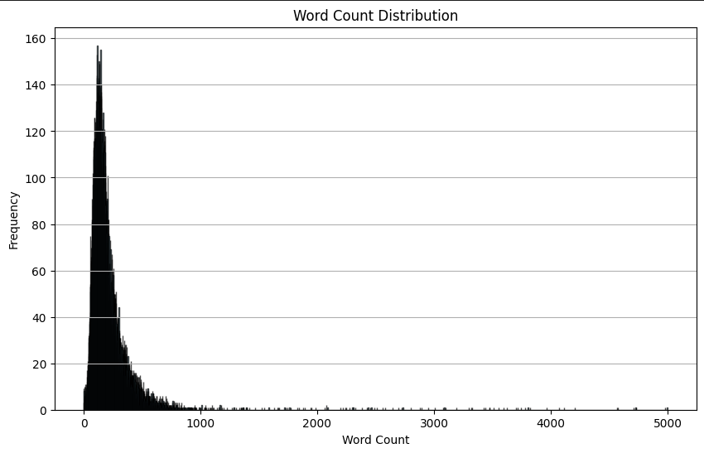
EDA
Preprocessing Steps
EDA

Slide 7

Thank You

